Slide 1



MINOR PROJECT-I BATCH – 35 Design and Simulation of Microstrip Antenna for Breast Cancer Detection
By
Naveena K [21BEC136]
Padmavathi S [21BEC141]
Pavipraveena G [21BEC142]
Pavithra G [21BEC143]
DATE:24/11/2022
Supervisor
Dr.D.JAYASEELAN

Slide 2
ABSTRACT
Breast cancer affects many women and has fatal conclusions if it does not cure correctly. Early diagnosis is the most important parameter to detect and interfere with cancer tissue.
Some of methods for breast cancer detection are X-ray mammography, MRI and ultrasound.
These methods have several limitations,so as a alternating method we design basic Micro strip antenna for early detection of breast cancer

Slide 3
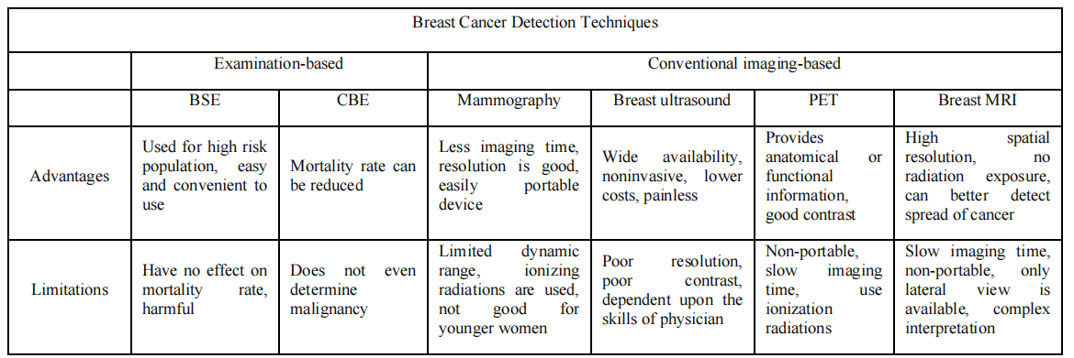
EXISTING METHOD

Slide 4
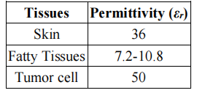
PROPOSED To detect the breast malignant cell and calibrate its cell stage accordingly,the antenna which we are going to design is placed over the breast structure In this work , we use dielectric properties of various tissue of breast phantom as a parameter to design antenna In this work, depending on permittivity values over the breast tissue with tumor and without tumor we are going to design antenna.

Slide 5
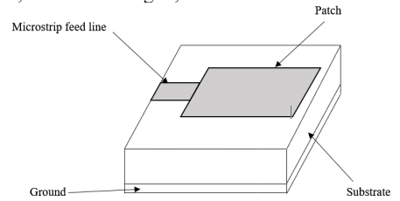
micro strip patch antenna

Slide 6
SIMULATION WORK
In this work, by investigating permittivity values over the breast tissue with tumor and without tumor,we are going to design antenna.
Microstrip patch antenna has merits over these in terms of light weight, small structure, easy fabrication and low cost
A microstrip patch antenna, consists of a conducting patch on one side of substrate and a ground plane on the other side of it.

Slide 7
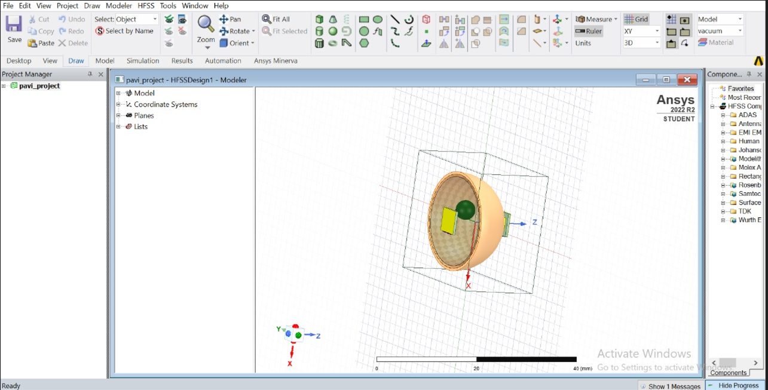
FINAL DESIGN

Slide 8
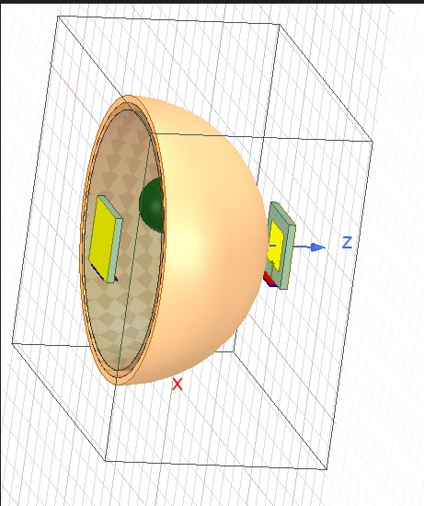
FINAL DESIGN

Slide 9
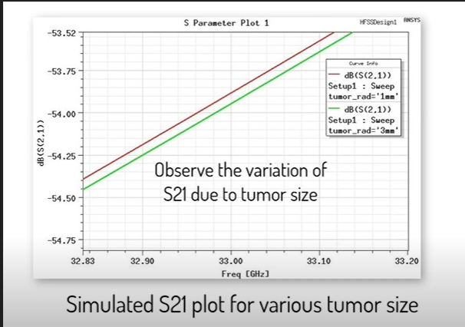
FINAL GRAPH

Slide 10
CONCLUSION
We completed studying our base paper for desiging micro strip patch antenna for early detection of breast cancer.
We have designed basic micro strip patch antenna with dielectric of tissues as a parameter for early detection of breast cancer detection.

